Slide 1


One-way Active Measurement Protocol (OWAMP)
CHAN YING LOK SIMON (08533566G)
QING PEI (11500811G)
LO WING YI (11523479G)

Slide 2
Project Objective
The purposes of this project are using an OWAMP implement one-way delay and packet loss and understanding how the OWAMP works

Slide 3
Outline
Understanding how the OWAMP works
Implementation of one-way delay and packet loss
Conclusions and Future Works

Slide 4
OWAMP Simplified Architecture
Control-Client
OWAMP-Control
Server
Fetch-Client
Session-Receiver
OWAMP Test
Session-Sender

Slide 5
Test Endpoints
The workstation (158.132.9.39) with Ubuntu 10.04 in Computer Science Laboratory (PQ605)
Other open OWAMP servers (137.189.27.6, 64.57.17.162, 206.12.24.110, 193.48.99.79, 130.246.179.197 & 90.147.67.252) located in Hong Kong and other foreign countries

Slide 6
Effect of Different Time Sources
On the hardware side, the system should be as stable as possible. In addition, the power management features should be disabled in BIOS to avoid frequently changing CPU clock rate, which may lead to subtle changes in system time
On the software side, NTP (ntpd) provides a synchronized clock on the local system by querying time from a network timeserver and logging the time drifts in a local file

Slide 7
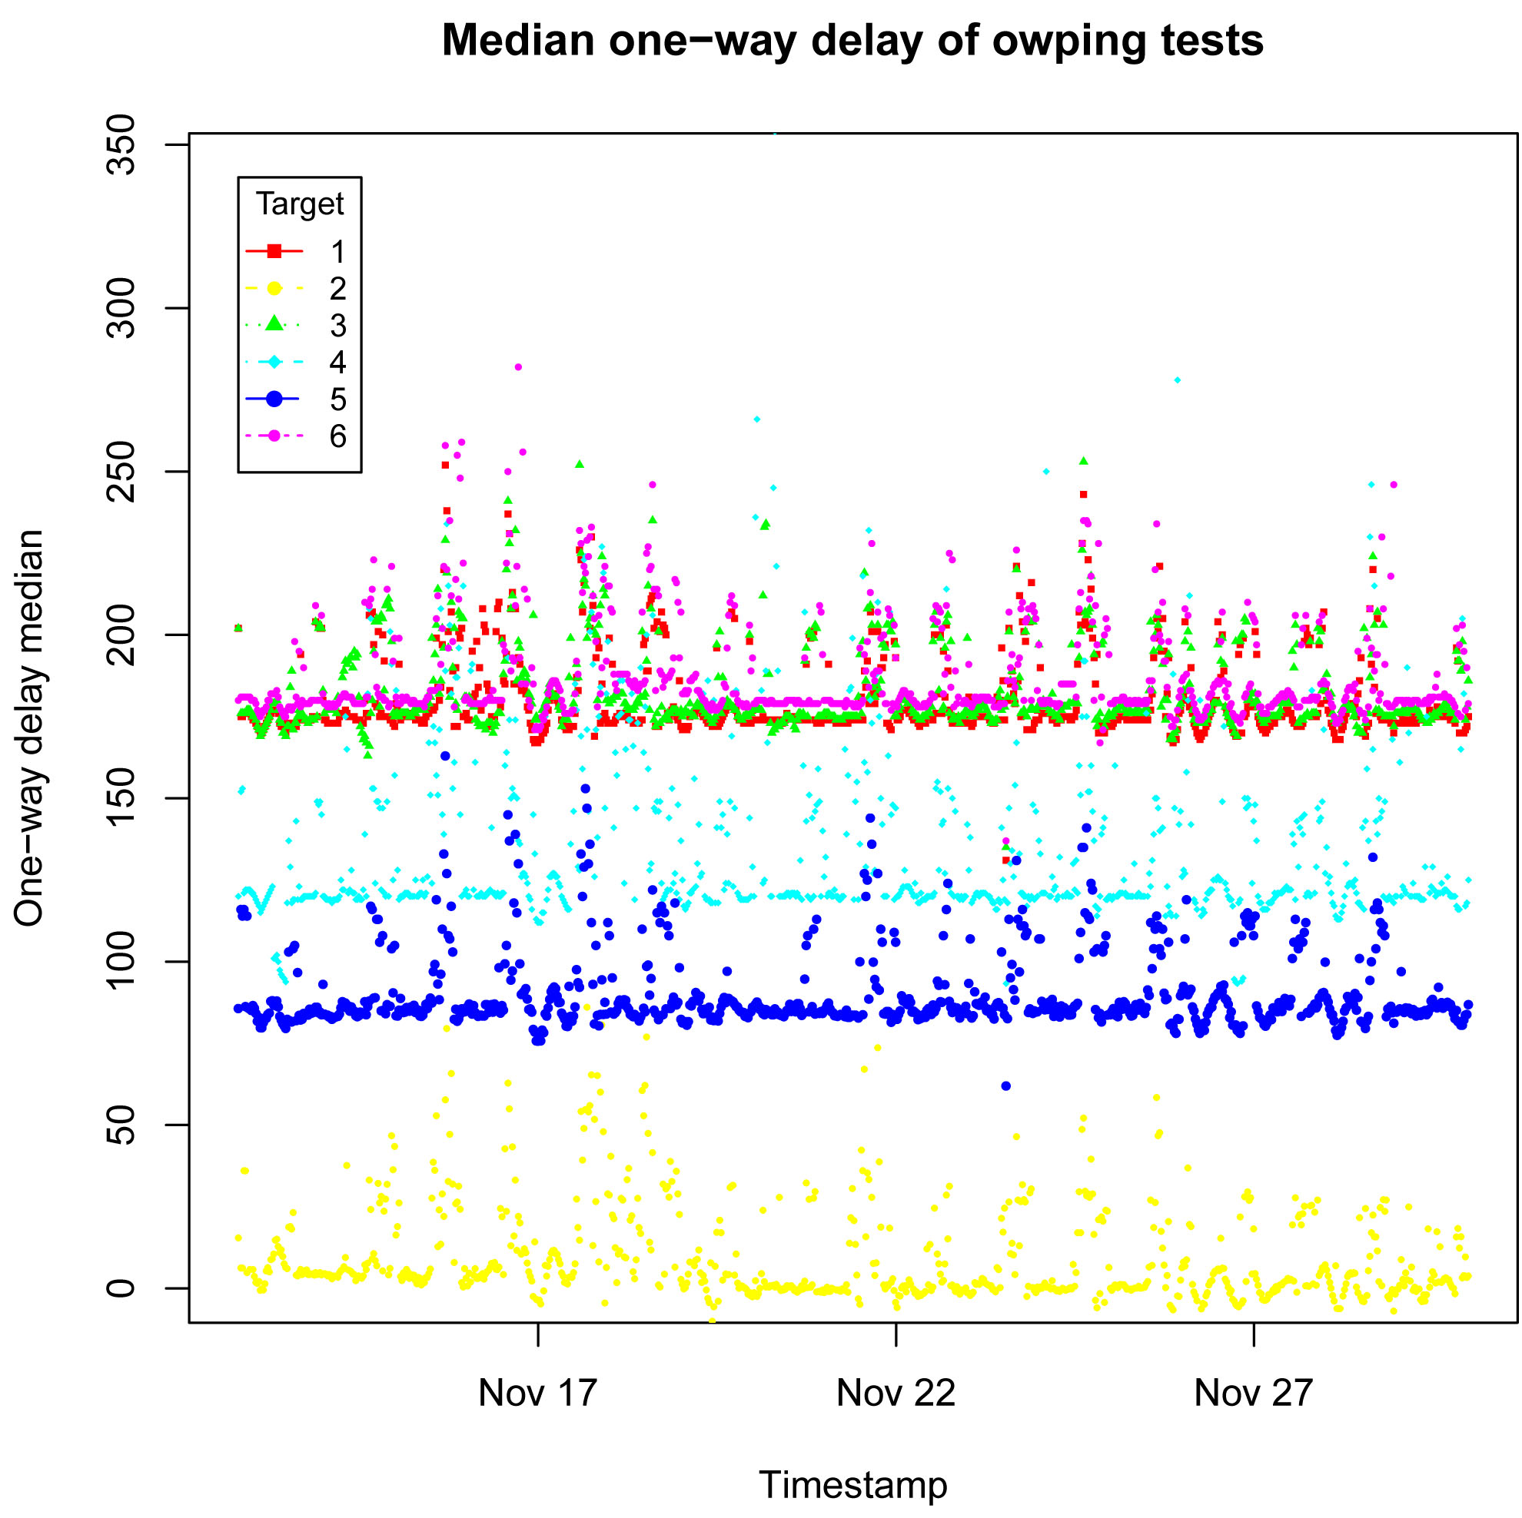

Slide 8
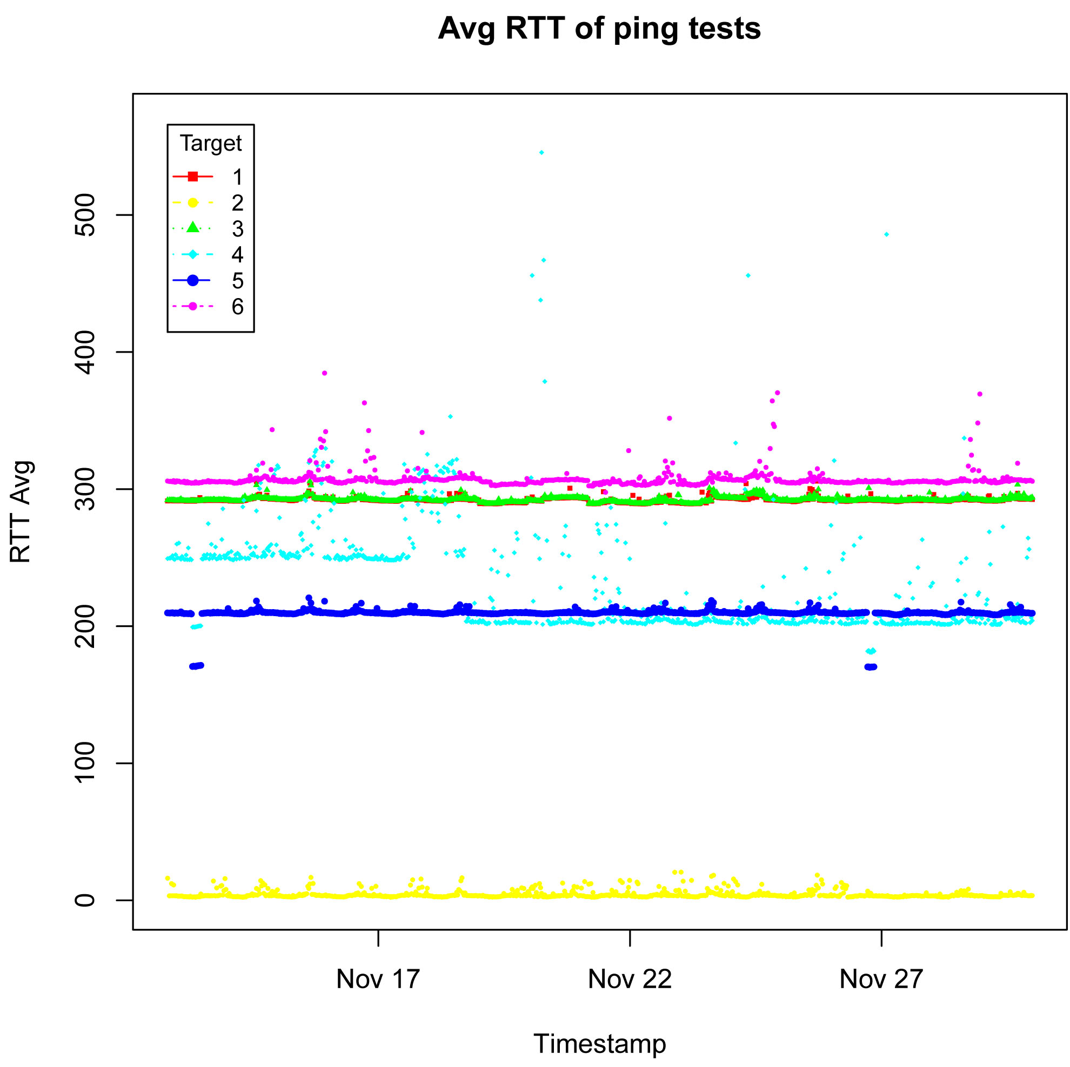

Slide 9
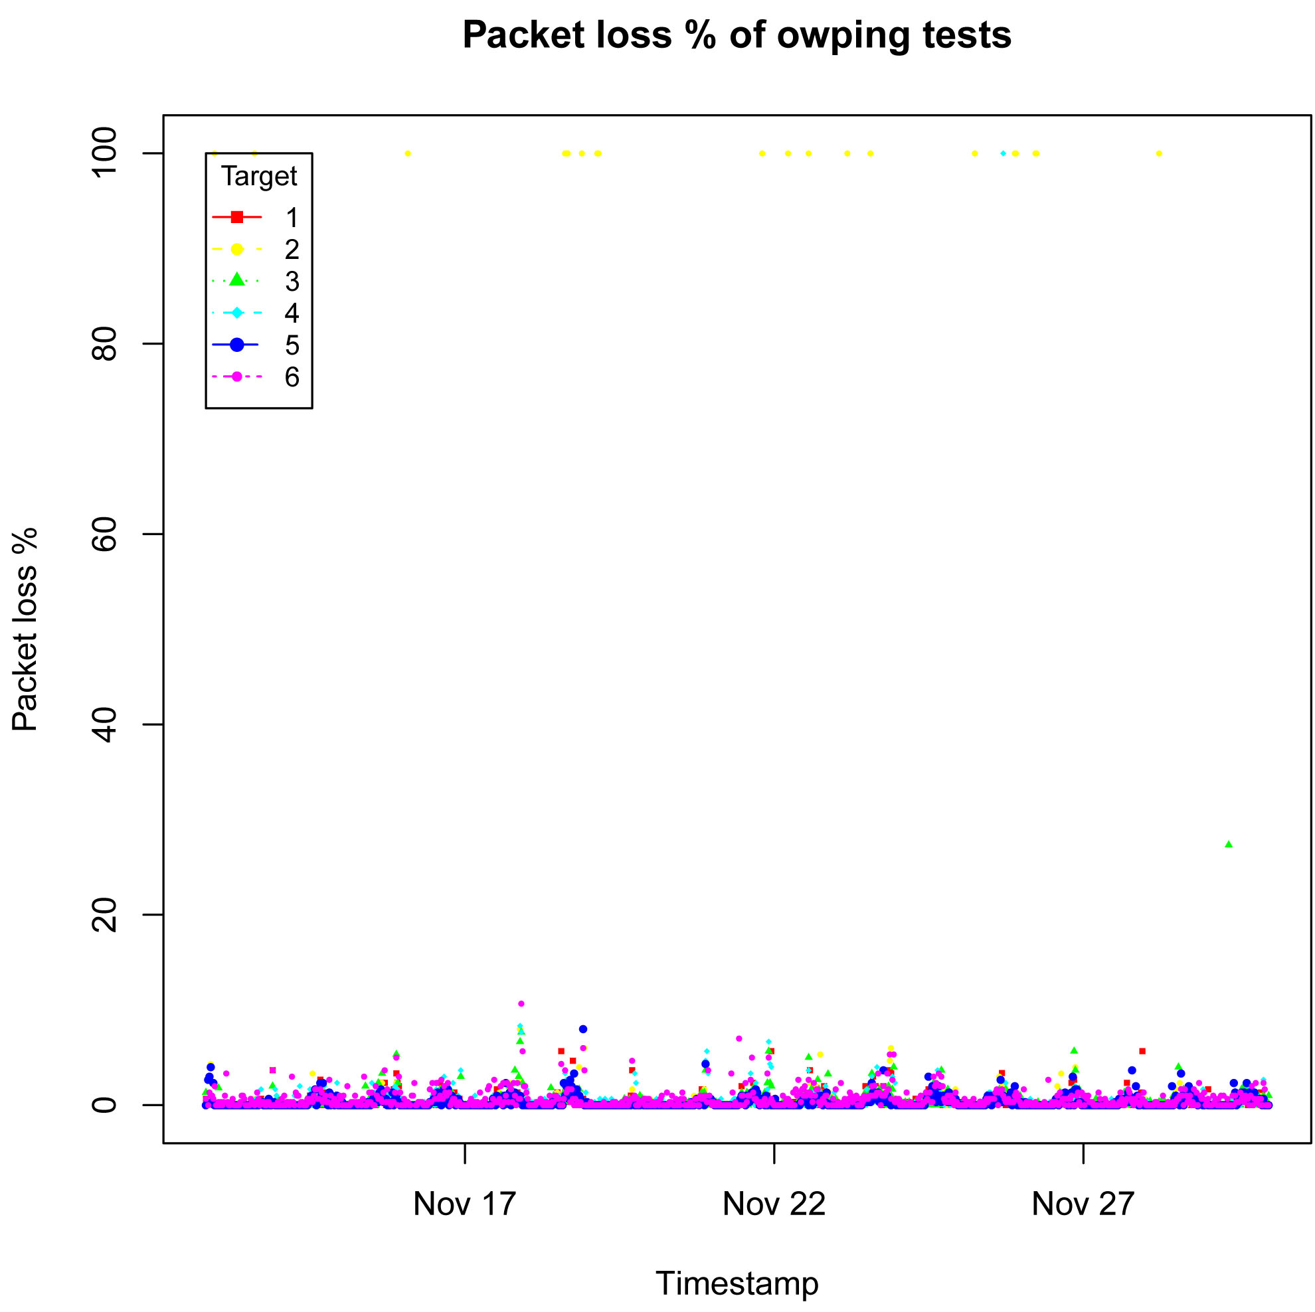

Slide 10
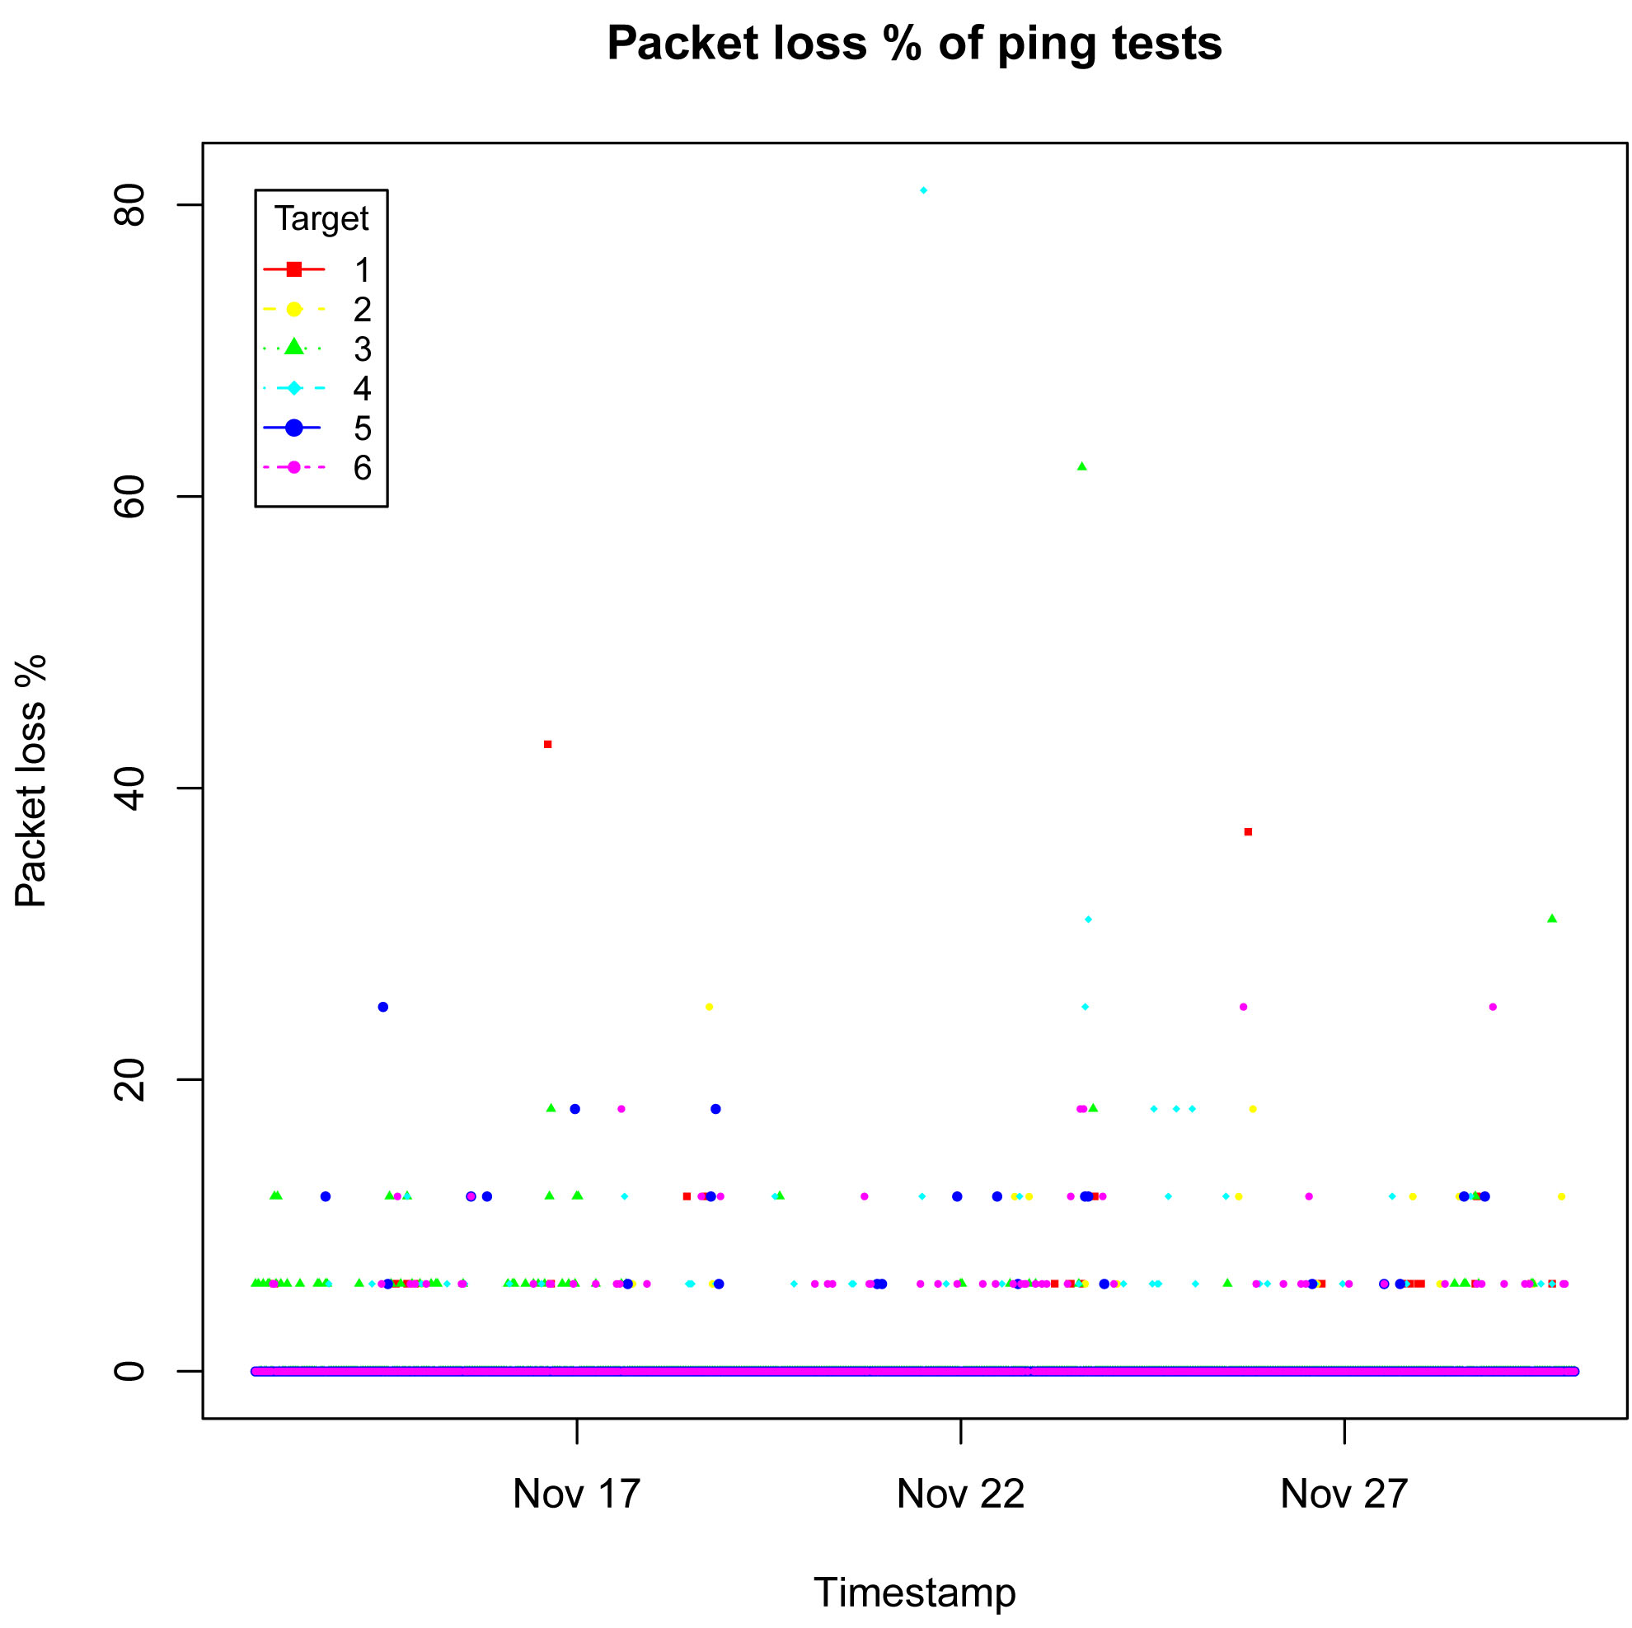

Slide 11
Summary of Testing Results
 | UK | HK | France | Canada | US | Italy
Median one-way delay of owping tests | 190 ms | 6 ms | 190 ms | 135 ms | 80 ms | 200 ms
Avg RTT of ping tests | 295 ms | 10 ms | 295 ms | 250 ms | 225 ms | 305 ms
Packet loss of owping tests | < 6% | < 6% | < 6% | < 6% | < 6% | < 6%
Packet loss of ping tests | < 20% | < 20% | < 20% | < 20% | < 20% | < 20%

Slide 12
Conclusions
Testing results from Monday to Sunday are similar reflecting that daily Internet traffic is similar
US has minimum one-way delay and RTT among other foreign countries because US’s Internet’s infrastructure is well developed as compared with other foreign countries
Packet loss of owping is less than that of ping because owping has a higher priority in server response

Slide 13
Conclusions
One-way delay is not equal to half of the RTT because (a) without accurate timestamp, clock synchronization in one-way delay affects the response result; (b) network traffic congestion delays the response ; (c) firewall or third parties program including port filter, policy or prioritize setting affect the response result; and (d) medium rounder, unexpected routers or workstations are shared between two endpoints actually

Slide 14
Future Works
Select more open OWAMP servers for testing
Carry out the testing in a longer period (e.g. 1 month)
Record the Information of passed hops so that the analysis of the results could be more comprehensive and representative
Use the same protocol to measure one-way delay between server and client

Slide 15
Q & A
COMP5311 Internet Infrastructure and Protocols

